Slide 1

Describing Data:
Frequency Tables, Frequency
Distributions, and Graphic Presentation
Chapter 2
McGraw-Hill/Irwin
Copyright © 2012 by The McGraw-Hill Companies, Inc. All rights reserved.

Slide 2
LEARNING OBJECTIVES
LO1 Make a frequency table for a set of data.
LO2 Organize data into a bar chart.
LO3 Present a set of data in a pie chart.
LO4 Create a frequency distribution for a data set.
LO5 Understand a relative frequency distribution.
LO6 Present data from a frequency distribution in
a histogram or frequency polygon.
2-<number>

Slide 3

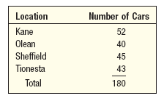
Frequency Table and Frequency Distribution
LO1 Make a frequency table for a set of data
FREQUENCY TABLE A grouping of qualitative data into mutually exclusive classes showing the number of observations in each class.
Class interval: The class interval is obtained by subtracting the lower limit of a class from the lower limit of the next class.
Class frequency: The number of observations in each class.
Class midpoint: A point that divides a class into two equal parts. This is the average of the upper and lower class limits.
FREQUENCY DISTRIBUTION A grouping of data into mutually exclusive classes showing the number of observations in each class.
2-<number>

Slide 4

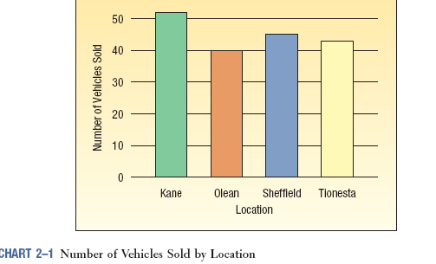
Bar Charts
LO2 Organize data into a bar chart
BAR CHART A graph in which the classes are reported on the horizontal axis and the class frequencies on the vertical axis. The class frequencies are proportional to the heights of the bars.
2-<number>

Slide 5
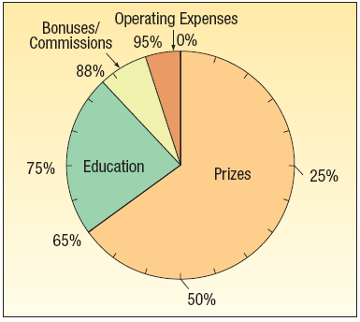
Pie Charts
LO3 Organize data into a pie chart
PIE CHART A chart that shows the proportion or percent that each class represents of the total number of frequencies.
2-<number>

Slide 6
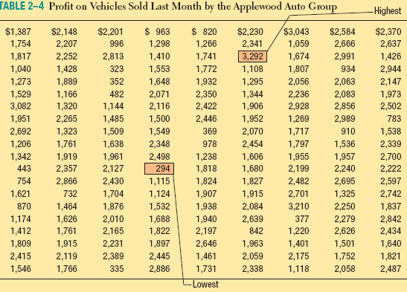

EXAMPLE – Creating a Frequency Distribution Table
LO4 Create a frequency distribution for a data set.
Ms. Kathryn Ball of Applewood Auto Group wants to develop tables, charts, and graphs to show the typical selling price on various dealer lots. The table on the right reports only the price of the 180 vehicles sold last month.
2-<number>

Slide 7


Constructing a Frequency Table - Example
LO4
Step 1: Decide on the number of classes.
A useful recipe to determine the number of classes (k) is the “2 to the k rule.” such that 2^{k} > n.
There were 180 vehicles sold, so n = 180. If we try k = 7, then 2⁷ = 128, somewhat less than 180. Hence, 7 is not enough classes. If we let k = 8, then 2⁸ = 256, which is greater than 180. So the recommended number of classes is 8.
Step 2: Determine the class interval or width.
The formula is: i ≥ (H-L)/k where i is the class interval, H is the highest observed value, L is the lowest observed value, and k is the number of classes.
  Round up to some convenient number, such as a multiple of 10 or 100. Use a class width of $400
2-<number>

Slide 8
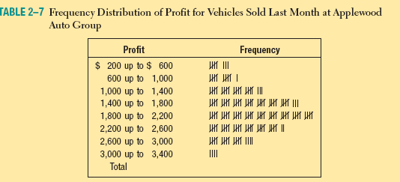
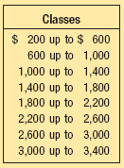
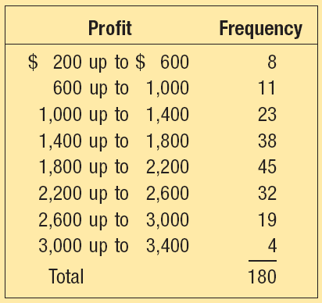
Constructing a Frequency Table - Example
LO4
Step 4: Tally the vehicle selling prices into the classes.
Step 5: Count the number of items in each class.
Step 3: Set the individual class limits
2-<number>

Slide 9

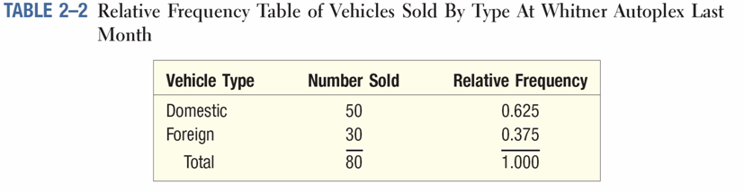
Relative Class Frequencies
LO5 Understand a relative frequency distribution.
LO4
Class frequencies can be converted to relative class frequencies to show the fraction of the total number of observations in each class.
A relative frequency captures the relationship between a class total and the total number of observations.
2-<number>

Slide 10
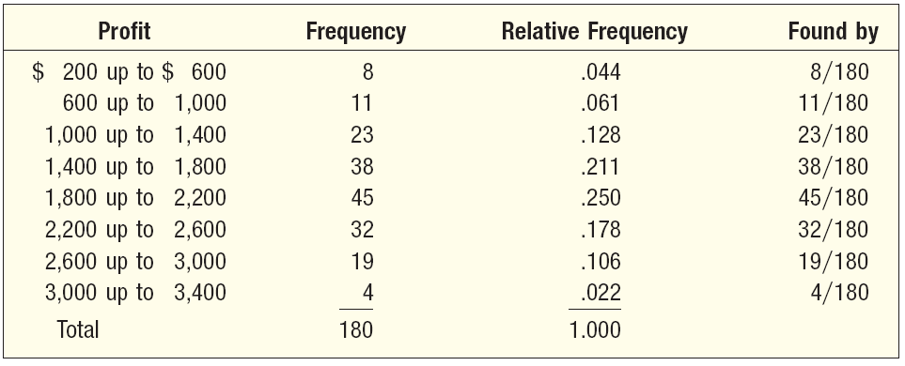
Relative Frequency Distribution
LO5
To convert a frequency distribution to a relative frequency distribution, each of the class frequencies is divided by the total number of observations.
TABLE 2–8 Relative Frequency Distribution of Profit for Vehicles Sold Last Month at Applewood Auto Group
2-<number>

Slide 11

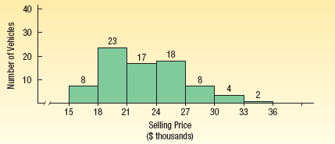
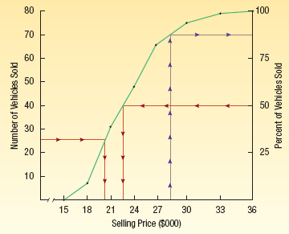
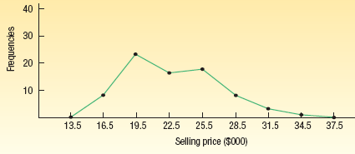
Graphic Presentation of a Frequency Distribution
LO6 Present data from a frequency distribution in a histogram or frequency polygon.
The three commonly used graphic forms are:
    Histograms
    Frequency polygons
    Cumulative frequency distributions
2-<number>

Slide 12
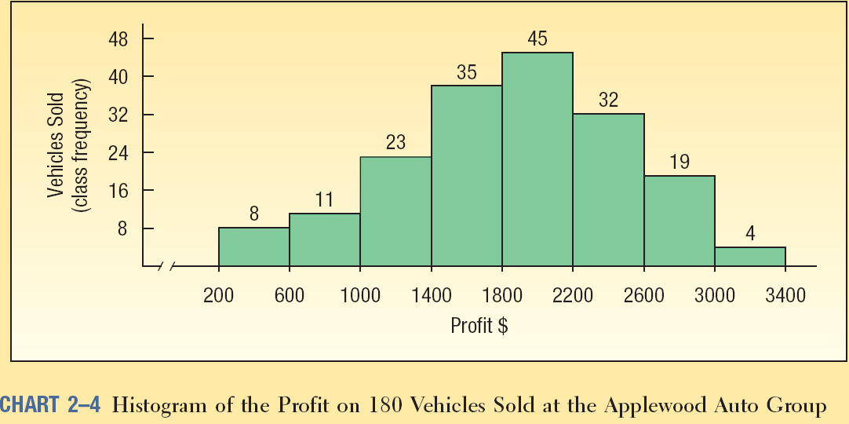
Histogram
LO6
HISTOGRAM A graph in which the classes are marked on the horizontal axis and the class frequencies on the vertical axis. The class frequencies are represented by the heights of the bars and the bars are drawn adjacent to each other.
2-<number>

Slide 13
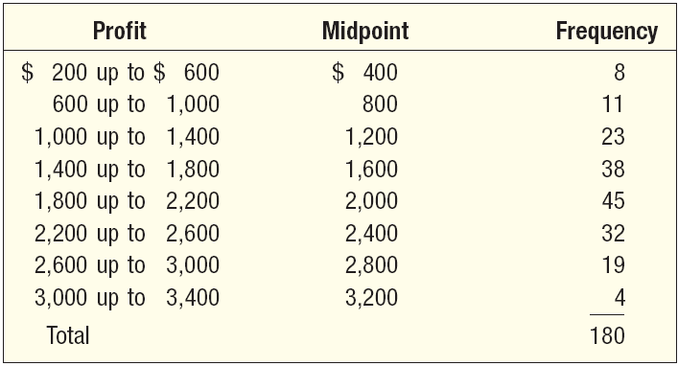
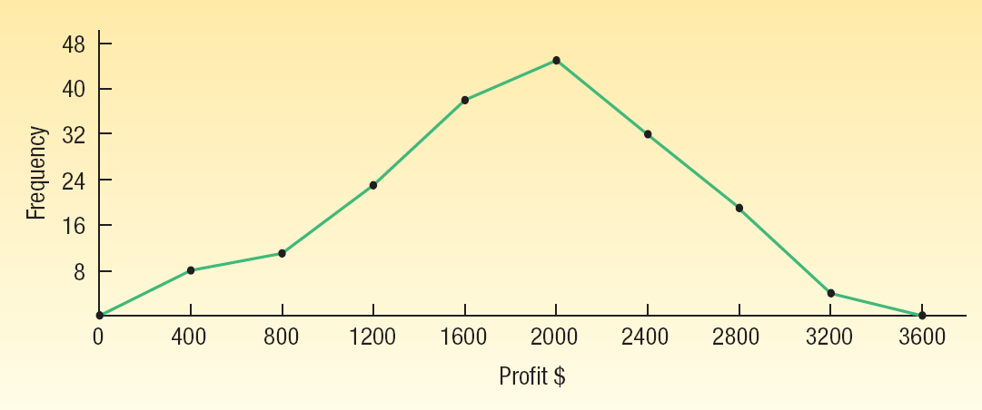
Frequency Polygon
LO6
A frequency polygon also shows the shape of a distribution and is similar to a histogram.
It consists of line segments connecting the points formed by the intersections of the class midpoints and the class frequencies.
2-<number>

Slide 14
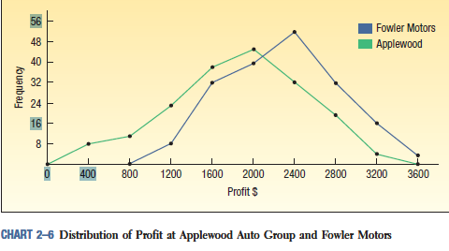
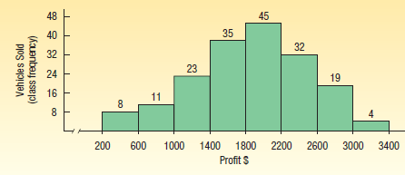
Histogram Versus Frequency Polygon
LO6
Both provide a quick picture of the main characteristics of the data (highs, lows, points of concentration, etc.)
The histogram has the advantage of depicting each class as a rectangle, with the height of the rectangular bar representing the number in each class.
The frequency polygon has an advantage over the histogram. It allows us to compare directly two or more frequency distributions.
2-<number>

Slide 15
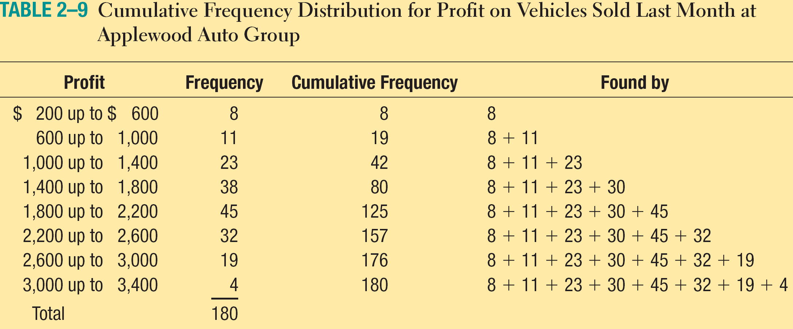
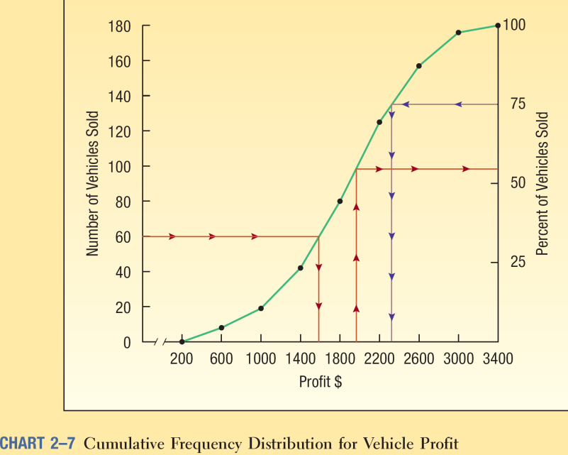
Cumulative Frequency Distribution
LO6
2-<number>

